Slide 1
Exploring Differential Equations via Graphics
By Mohammad H. Chaghazardi
Fall – winter 2010 C++ course – DR. Bahram Taheri

Slide 2
Where are we goin’ ?
In this presentation we are going to get familiar with solving diff equations via graphics
Note:
Graphics let you discover the solution!
You have to refer to numbers for exact answers!

Slide 3
Where are we goin’ ?
First Order Equations
Solving equations with integrals which are not Antiderivaties
Taylor Series

Slide 4
First Orders !
“First order Equations are equations which contain first order diffusions.”
In ordinary equations Right hand-side are consist of X and Y.

Slide 5
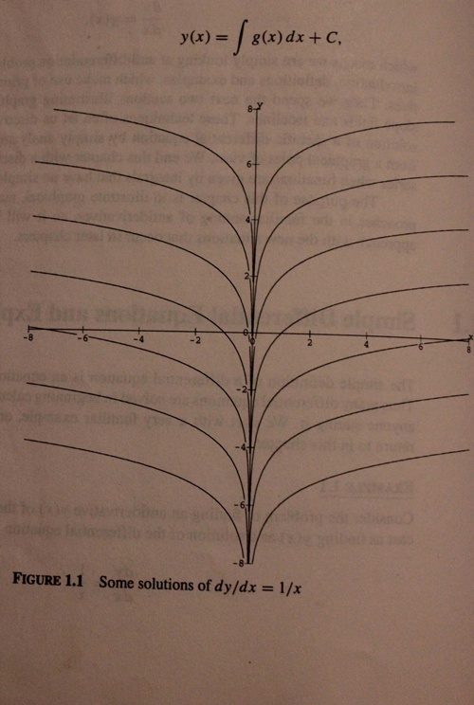
First Orders !
Ln(x)+ constant
Analytycal
Graphical
Simple Sample

Slide 6
Tips for Hand-Drawing a Slope
What is the value of F(x)?
What is the relationship between F(x) and F(-x)?
Find the amount at some points!
Check the special situation
When x goes to inf !
When goes to –inf !

Slide 7
But if…
You are given an equation which an analytical solution is not available for or strange to find ??
dy/dx=sin(x)/x y(x)=?

Slide 8
The Numerical Solutions will do the trick
The description available in following pages.

Slide 9
Types of Drawing a Graph
Vector fields
The system which is used to show the fields that have both direction and size
Scalar Graphs
The system which is used to show the Graphs that only have sizes

Slide 10
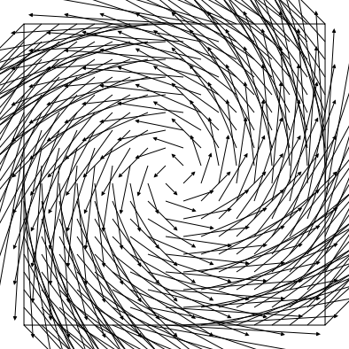
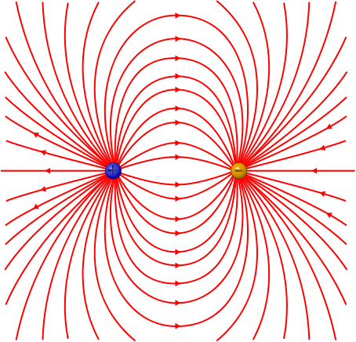
Vector Fields
Field Drawing styles

Slide 11
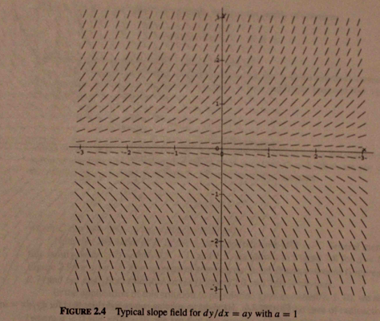
Scalar Graphs

Slide 12
Ways of Drawing
Graph
Slope
Honestly, there is no big differences between these two ways but, we describe some points

Slide 13
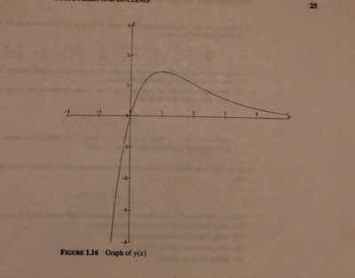
Graphs
Shows a relation between Y and X by pin pointing each amount

Slide 14
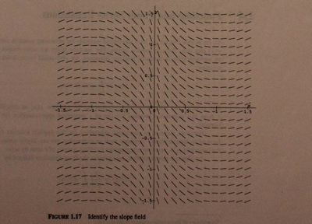
Slopes
Try to cover up all the page and show the functions which are separated by a constant C.

Slide 15
But if - answer
Numerical Solutions
Sometimes it’s too hard for a human to solve the equations by analytical ways, but the computer can solve the equations via calculating X and Y at each point we are giving to it!

Slide 16
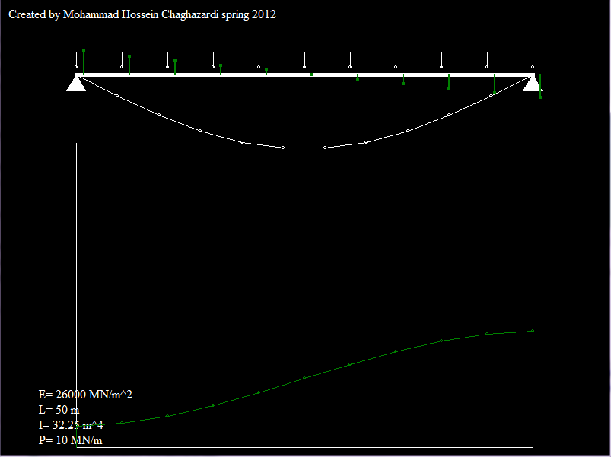
Numerical Solutions
Sample :
Beam deflection

Slide 17
Numerical Solutions
Sample :
Beam deflection
Find it Challenging?
Click here for more information
C++ source file
Executable file

Slide 18
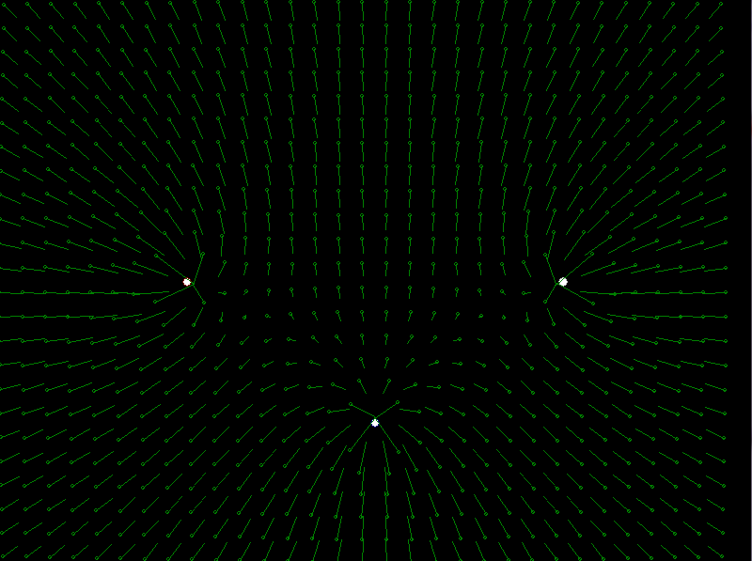
Electric Fields
Another example for numericals
C++ source file
Too long(200 lines) to understand, suggest you to write the program by yourself
Description(Persian)
Executable file

Slide 19
Numerical Solutions
In the last couple of samples we used to solve equations which were consisted of second order diffusions.
In the “Beam Deflection”, we could saw a simple equation with an ordinary right hand side matrices which the PDF file outlined well.
And in the “Electric Fields” we solved the Gauss's equation.

Slide 20
For more information we highly suggest you to read the following texts and references to get familiar with solving the problems in both ways we described in advanced.
Thank you!
1. For checking all of the graphical statements in BGI C++ refer to hear.
2. An introduction to Electro Dynamics, by David J. Griffiths
3. Exploring Differential Equations via Graphics and Data,
by David Lomen and David Lovelock , John Wiley & Sons, Inc
ISBN: 0-471-07649-X

